Slide 1
Battle of Neighborhood
Analysis for best Restaurant on Kolkata, India

Slide 2
Created by Sayan Manna

Slide 3
Introduction
The analysis is done on python jupyter notebook. I have taken the support of important libraries like pandas, gropy, numpy, folium.
The program also uses foursquare API to get the latitude, longitude, venue names, venue types of the particular neighborhood.

Slide 4
Problem
The analysis is done for the people who wants to open a restaurant or shop near the neighborhood of Kolkata, India.

Slide 5
The Data
The data has been collected by searching various websites.
I have made the dataset from several websites from where we have extracted the data.
The list of websites :-
https://en.wikipedia.org/wiki/Kolkata_district
https://en.wikipedia.org/wiki/Neighbourhoods_in_Kolkata_Metropolitan_Area
https://en.wikipedia.org/wiki/Category:Neighbourhoods_in_Kolkata

Slide 6
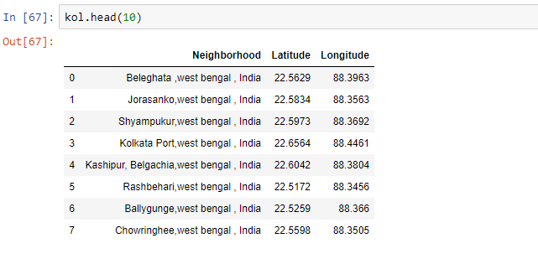
The dataset screenshot with latitude and longitude

Slide 7
Methodology
For this report we have used few different maps for the analysis to open a restaurant in Kolkata with its neighbourhood .
We have used folium to create those maps.
We have collected the list of venues and the type of venues by using foursquare API.
We have used geopy to obtain the precise latitude and longitude of the neighbourhood.
We obtained the result and made analysis and segregated the result to obtain the best possible type of restaurant to open in the neighbourhood of that place.

Slide 8
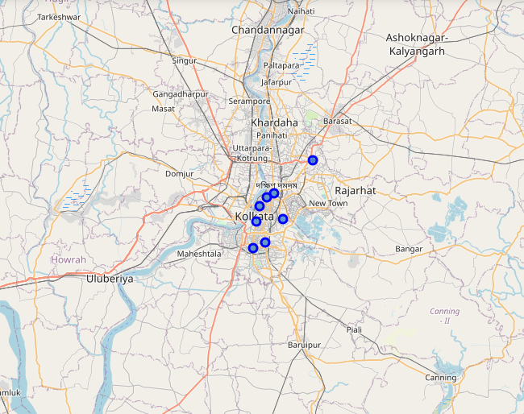
The map of neighbourhood of kolkata
We have made the visualization of the neighbourhood of Kolkata using folium library.
The dotted points shows the location of the neighbourhood made by using geopy library to retrieve their individual latitude and longitude.

Slide 9
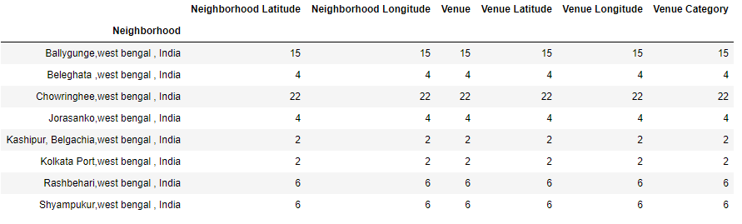
The list of the neighbourhood with number of venues, category, latitude and longitude.

Slide 10
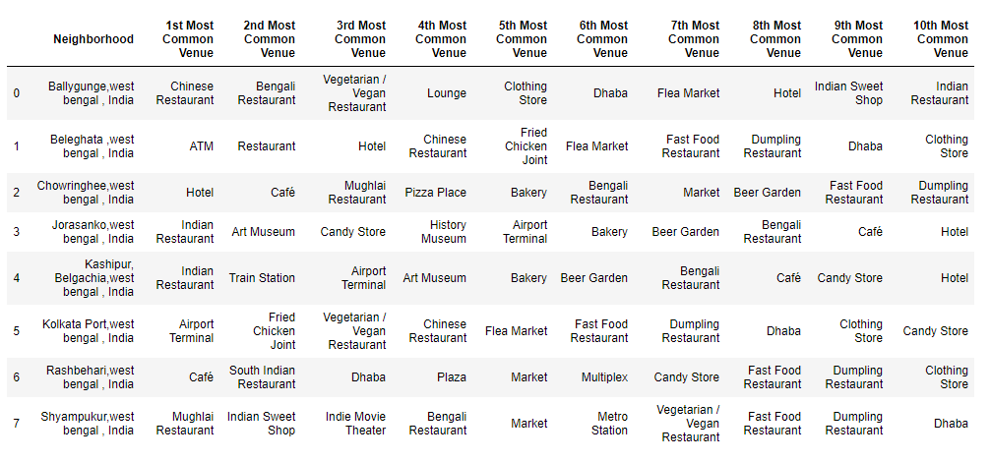
Full details of the analysis along with the common venues available to that neighbourhood in descending order of their likelihood.

Slide 11
Result
Clustering all the results and comparing all results we found out that it is best to open a Indian restaurant especially Bengali restaurant in the central Kolkata.

Slide 12
Conclusion
The report may be helpful to the people who wants to open a shop in Kolkata. However there is a huge fallacy in the report. I have collected the latitude, longitude, type of venue of the restaurants from the neighbourhood of Kolkata by using foursquare API. But the foursquare API did not give me the satisfied amount of name of restaurants. The foursquare API did not work properly on Indian cities unlike on other foreign cities where it works perfectly. Since I have not been allowed to use any other API and neither I am aware about so the report is satisfactory with regards of the use of foursquare API.

Slide 13
THANK YOU!
Sayan Manna
Email:
sayanmanna1233@gmail.com

